Slide 1
WP2 Building pathology
By Henk Vermande
Forum meeting 7, DG ENTR, Brussels

Slide 2
Outline
Business models for the operation of a future pathology database
Conclusions

Slide 3
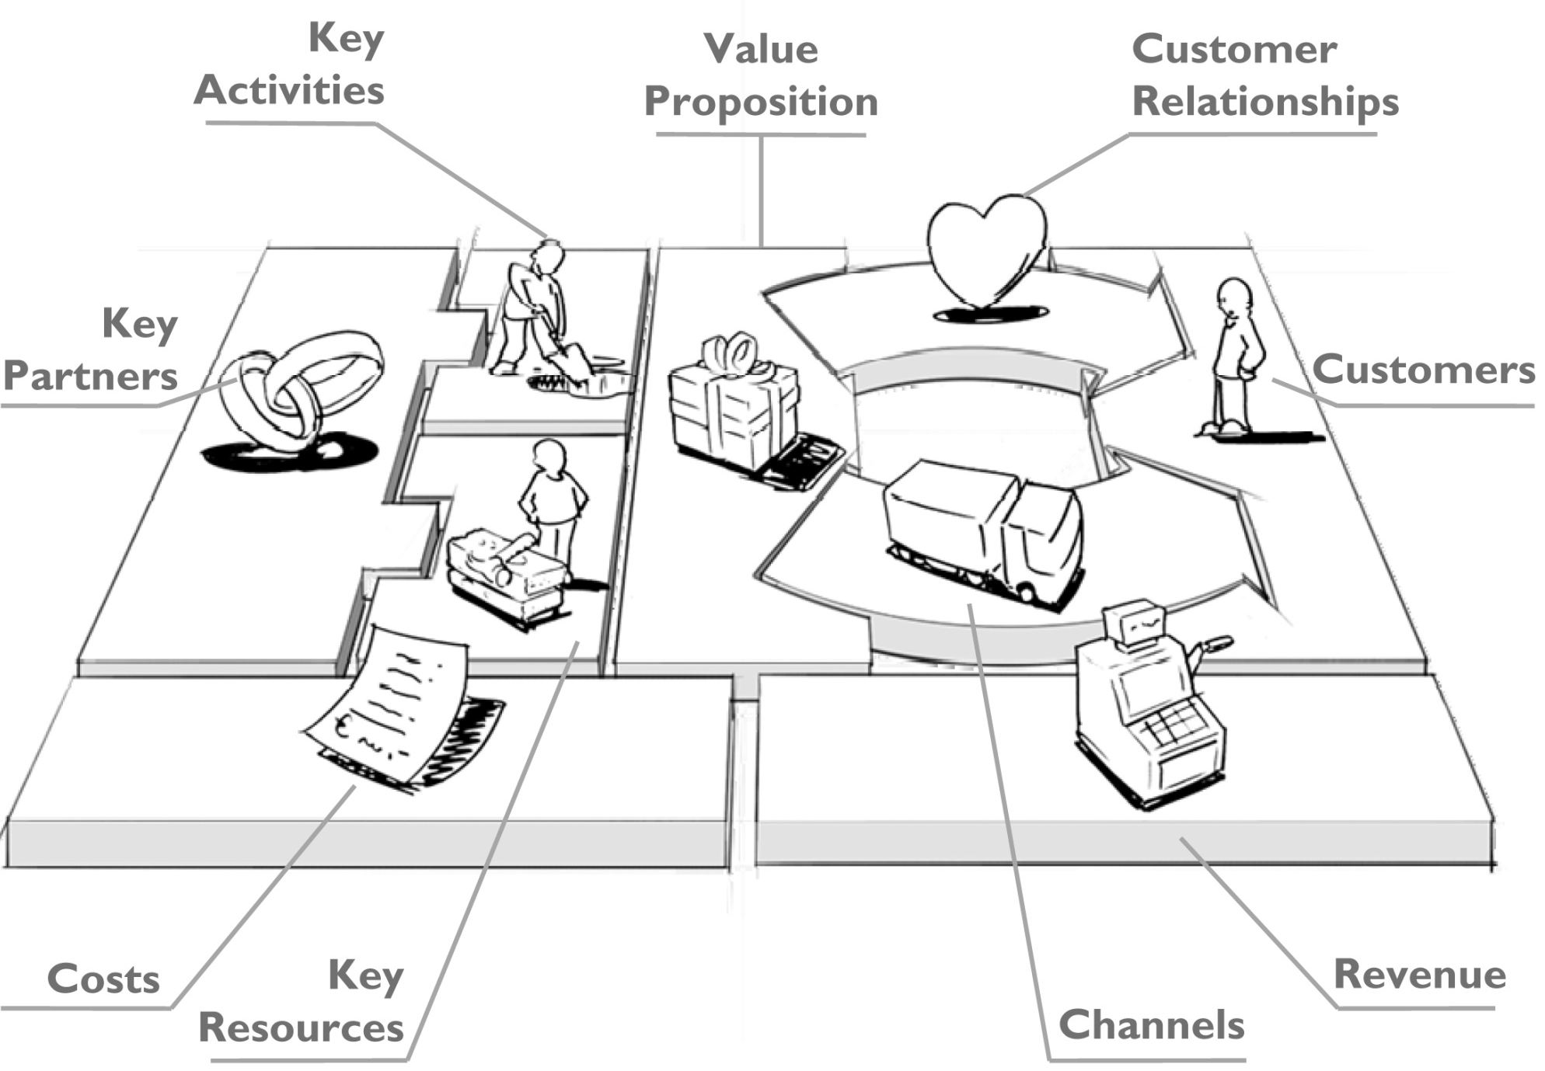
Business model canvas (Osterwalder & Pigneur)

Slide 4
Value Propositions
Evidenced:
Giving access to information on pathology cases presented in a uniform way;
Providing a ‘Warning procedure’ (or hazard notification procedure), where interlocutors in each country can report issues/defects;
Providing an overview of quality signs for eco-technologies;
Potentially:
Providing a tailored risk analysis of certain eco-technologies for specific customers;
Research institutes could quickly investigate the transnational joint pathologies.
Pathology information sheets with ‘lessons learned’, for example education or training institutes.

Slide 5
Revenue Streams
Usage fee: each customer pays a fee for access to the database. The more a service is used, the greater the revenue streams.
Subscription fees: customers buy (monthly or yearly) a continuous access to the database.
Consultancy fees: customers pay for certain products or services delivered by the EQEO organisation, e.g. publications, pathology information sheets, risk analysis, etc.

Slide 6
Activities
Collecting data, maintaining a database and secretariat, quality management;
Possibly:
Evaluation of data;
Technical expert analysis;
Publication of (evaluated) information and dissemination;
Inspectors visiting building sites;

Slide 7
Business models for the future database/EQEO
Non-profit with free public access;
(Semi-)commercial with access on a subscription basis;
Mix of commercial – non-profit
‘Give-and-take’ with limited access to a group of partners;

Slide 8
Weighting
 | Access | Scope | Cost
Model 1: Non-profit | ++ (free public access) | ++ (can be as broad as the sponsors want) | - (no revenues)
Model 2: Commercial | - (paid access) | +/- (scope depends on commercial revenues) | ++ (profit-based)
Model 3: Semi-commercial | +/- (some services for free, others against a fee) | + (scope depends partly on commercial revenues) | +/- (partly profit-based)
Model 4: ‘Give-and-take’ | - - (limited access to a group of partners) | +/- (scope is limited to, and depending on the input of the partners) | ++ (low costs to collect data)

Slide 9
CONCLUSIONS

Slide 10
1. ‘Quality in construction’ for insurers
Building pathology can be considered as the appearance of lack of quality (or ‘non-quality’) of construction works.
‘Non-quality indicators of construction’ are in fact statistical indicators of a large set of building pathology data.

Slide 11
2. Availability of building pathology data
Literature:
Mostly on deterioration and remedial work of ancient work and traditional building methods;
But: defects of some eco-technologies have been studied for a number of years and received some attention;
Insurers:
Confidential;
National organisations (AQC, Danish BDF, NHBC, Woningborg):
Only for a specific purpose and for their local market;
Other organisations:
Not in a systematic manner;
Information on defects of eco-technologies is scarce anyway;
Mostly low-key: for internal knowledge-sharing, ‘do’s and don’ts’, lessons learned.

Slide 12
3. Relationship between risk assessment and building pathology
Pathology information may help the insurer in his risk assessment:
Qualitatively
Quantitatively
For innovative products/technologies, there is less to no historical information available from claims.
The information from claims is usually not very useful.
Pathology information on innovative products/
technologies can only be used qualitatively.

Slide 13
4. Needs from insurers
A database with pathology records, that provides qualitative technical information on the pathology of eco-technologies (without any statistical data disclosure of claims).
A ‘Warning procedure’
An overview of quality signs for eco-technologies

Slide 14
5. Pilot pathology database
The pilot database was populated with 64 pathology cases, representing experiences with defects and failures of 4 eco-technologies in 10 countries.
The distinction between defect and failure is, and remains difficult in practice.
The field most often used was “general description of the pathology”.

Slide 15
6. Support for an EQEO
Support by a significant number of people in the European construction industry.
Insurance Europe: “supports the objective of increased availability and exchange of information on a cross-border level, and believes that the EQEO could be the right platform for such exchange (…) It has the potential to improve the quality and availability of the information for insurers and other stakeholders in the construction sector dealing with eco-technologies on a regular basis. Such data-gathering initiative should also help reduce knowledge deficits during the underwriting process (i.e. when insurers assess the risk)”.
CEBC:
CEBC can agree on the principle of the creation of the EQEO.
EQEO can help to reduce this huge cost of non quality (5-15% of turnover).

Slide 16
However:
Pathology information is scarce;
Transfer of knowledge on pathology from one country to another and making the information comparable is difficult.
It would be necessary for each technology to describe the specific constructive and climatic issues.
Keeping the database up to date is difficult.
Finance
It would need incentives and for the active members of this observatory.

