Slide 1
WP3 – General Perspective
By Thomas Dunand, Hannover Re
Forum Meeting 7, DG ENTR, Brussels

Slide 2
Framework
Goal:
    Facilitate Construction Insurance Access
Underlying goals:
    Free Trade
    Consumer protection
    Construction Quality

Slide 3
Construction Regimes
A systemic perspective
Wealth
User
practices
Insurance
Technology
Markets
Legal framework
Culture
Environmental conditions
System Configuration

Slide 4
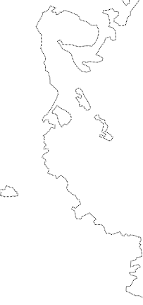
Construction Regimes

Slide 5
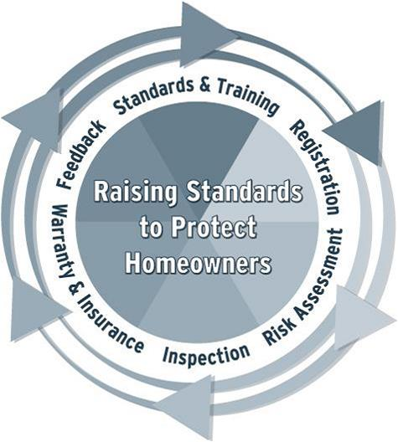
Construction Regimes - UK
“Anglo-Saxon” System
Integrated Solution
Voluntary
Market driven
NHBC

Slide 6
Construction Regimes - France
“Etatique” System
Segmented Solution
Compulsory
Legal basis
AQC
INSURERS
TIS

Slide 7
Construction Regimes - Denmark
“Corporatist” System
Specific Solution
Compulsory
Legal basis
BYG-ERFA
SBi
DBDF
auto reporting
DBDF
TIS optionnal

Slide 8
Construction Regimes - Germany
Differenciated Solution
Insurance / Financial
Legal / Market solution
insurers
no centralized reporting
Architects
insurance
Contractors
financial
TÜV

Slide 9
Construction Regimes

Slide 10
Construction Insurance
Guarantees Scope :
Third Party Liability (TPL)
  Manufacturer (Product Liability) : product
  Contractor : work
  Architect / Engineer (PI) : design
Inherent Defect Insurance (IDI) : work
Energy Performance Guarantees : work

Slide 11
Construction Insurance Regimes
Level of protection
Non consequential Financial Loss
Non consequential Financial Loss
Consequential Financial Loss
Consequential Financial Loss
Third
parties
Third
parties
Whole Building
Whole building
Damage to the work itself
Start of Work
Handover
+ 10 years

Slide 12
Expectation of Policy Convergence mechanisms*
Mechanism | Factors affecting convergence scope | Factors affecting convergence degree | Expected convergence direction
Imposition | Reach of the imposing actor (individual country vs. international institution) | (by definition full convergence to imposed model) | No prediction possible
International harmonization | Number of member countries | Degree of legal specification | Upward shift for minimum harmonization
 |  | Capacity to enforce compliance | Persistence for total harmonization
Regulatory competition | Market economy Trade-related policies | Trade dependence | Upward or downward shift for product standards
 |  |  | Downward shift for process standards
Transnational communication | Apart from information about policy choices of other countries no particular restrictions apply | Degree of existing similarity (number of adopters) | Upward shift in case of policy promotion For other mechanisms no prediction possible
 |  | Cultural linkages
 |  | Degree of model specification
 |  | Similarity of policy legacies
 |  | Degree of inter-linkage into transnational networks
Independent problem-solving | Number of countries that recognize similar problem | Degree of existing similarity across countries | No prediction possible

Slide 13
Improving the access process …
Wealth
User
practices
Insurance
User
practices
Insurance
Wealth
Technology
Technology
Markets
Markets
Legal framework
Legal framework
Culture
Culture
Environmental conditions
Environmental conditions
System Configuration Country A
System Configuration Country B

Slide 14
... through transnational communication
Help insurers assess risks
  Share pathology knowledge (EQEO)
  Share QS identification (QS Directory)
  Harmonize TIS accreditation
  Facilitate subscribing
  Procedure guide (PSC national sites)
  EU level complaint procedure (Mediator)

